Slide 1
AR Assisted Orbital Floor Implant Shaping
Augmented Reality Course Project
Yihao Liu
Mentors: Wenhao Gu , Ehsan Azimi, Dr. Peter Kazanzides

Slide 2
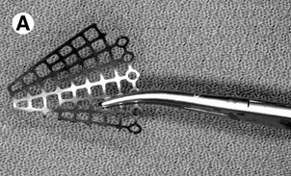
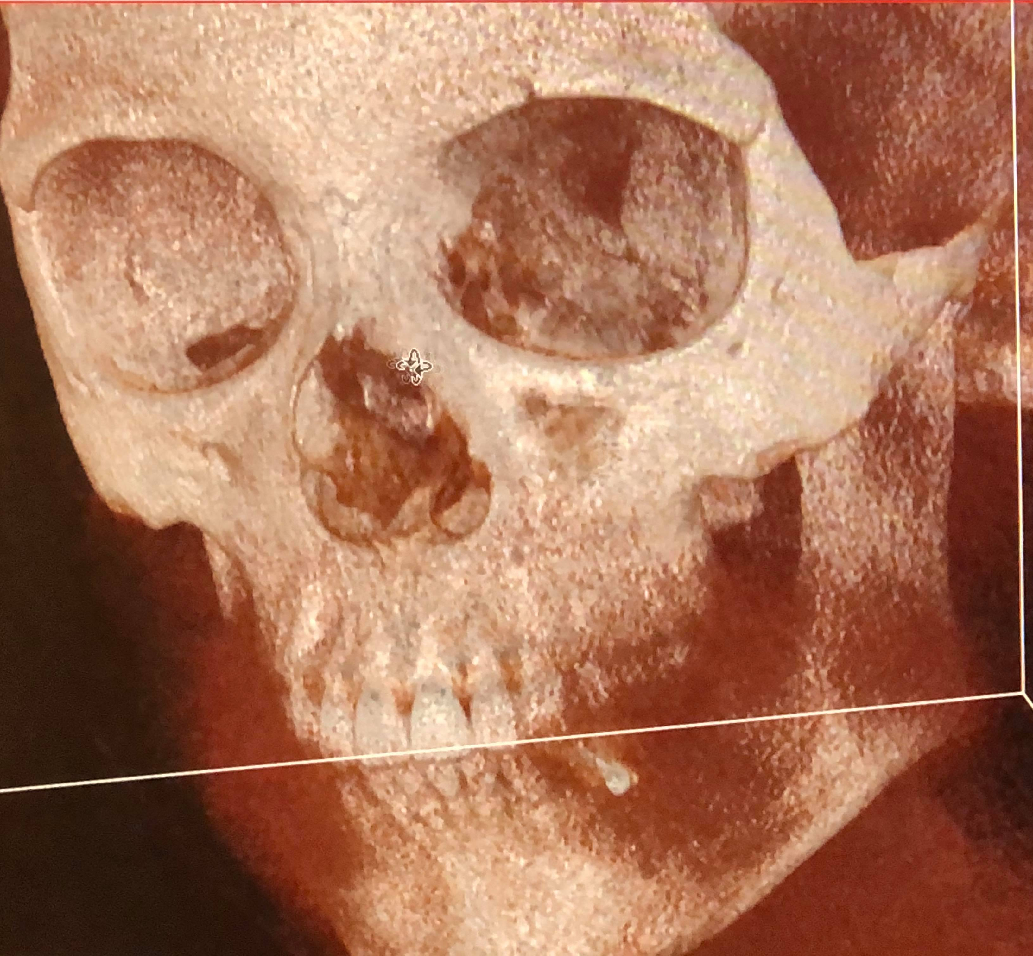
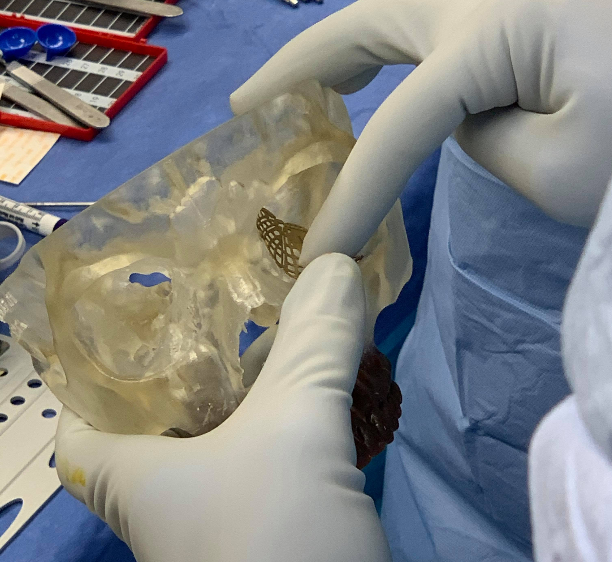
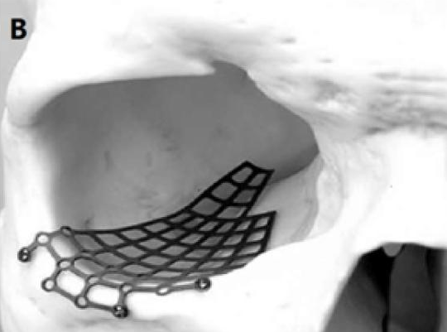
Background
Orbital floor reconstruction
Fractured eye socket bones
Place an implant
[1] Kazanzides, P. (2020). Navigation for Orbital Floor Fracture Repair. [PowerPoint Slides]

Slide 3
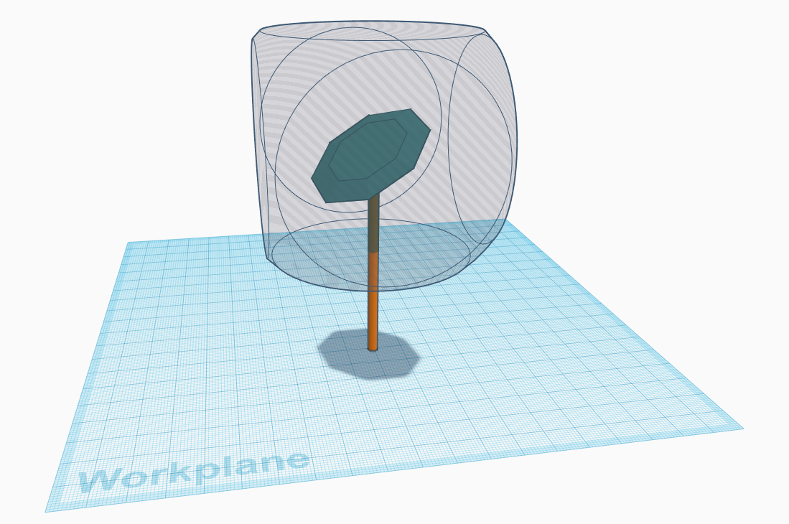
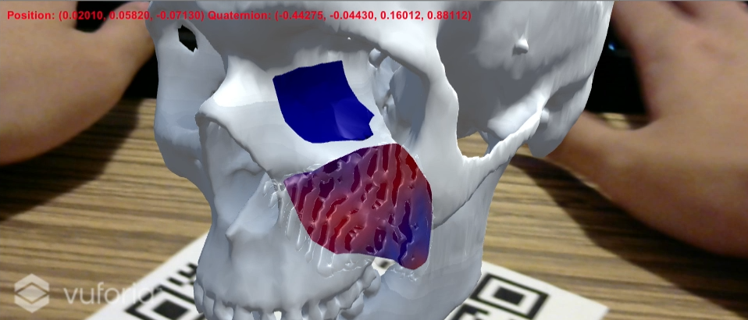
Motivation and Solution
Orbital floor reconstruction
Fractured eye socket bones
Need: correct shape of the implant
Takes time and trials in surgery
Completed solution:
Manually move the implant to skull
Digitize implant and calculate heat map to show discrepancy
Red: high discrepancy
Blue: low discrepancy
Blue region on skull: ideal location of implant. The region is derived by searching the closest points on the skull surface to the implant that was placed in eye socket
Display corresponding eye socket area
Display a highlighted area using mesh

Slide 4
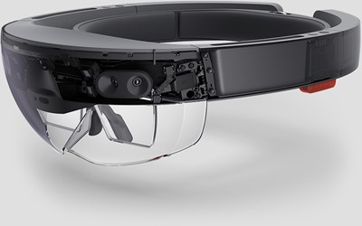
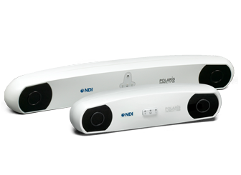
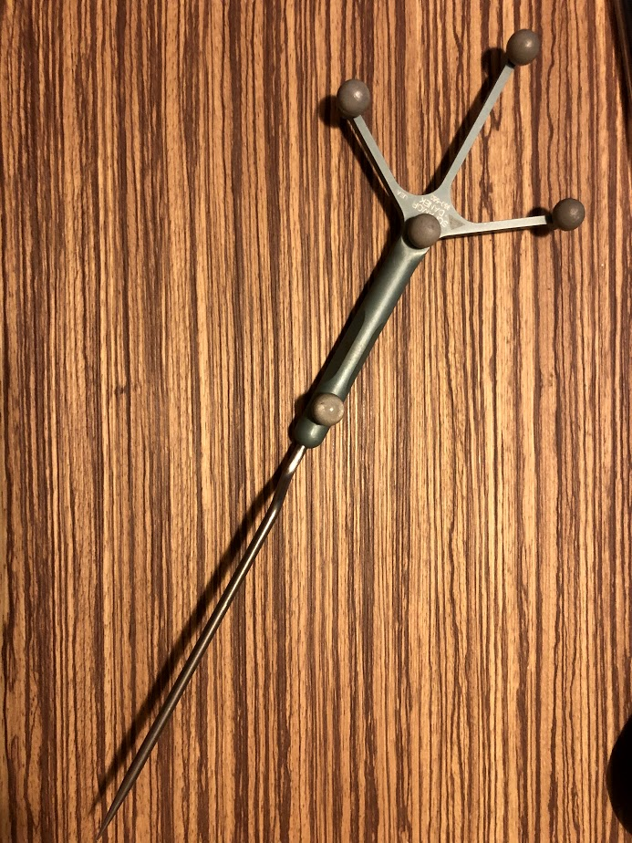
Solution
Implant Surface Digitalization
Option1: Inside-out, HoloLens
Tracked pointer: AR checkerboard marker
Option2: Outside-in, Polaris
Tracked pointer: Passive reflective ball markers
Transformation between Polaris and Unity
attached marker frame
Heat map calculation
Closest point algorithm
Octree data structure
Polaris image and product info: https://www.ndigital.com/medical/products/
Hololens image and product info: https://docs.microsoft.com/en-us/hololens/hololens1-hardware

Slide 5
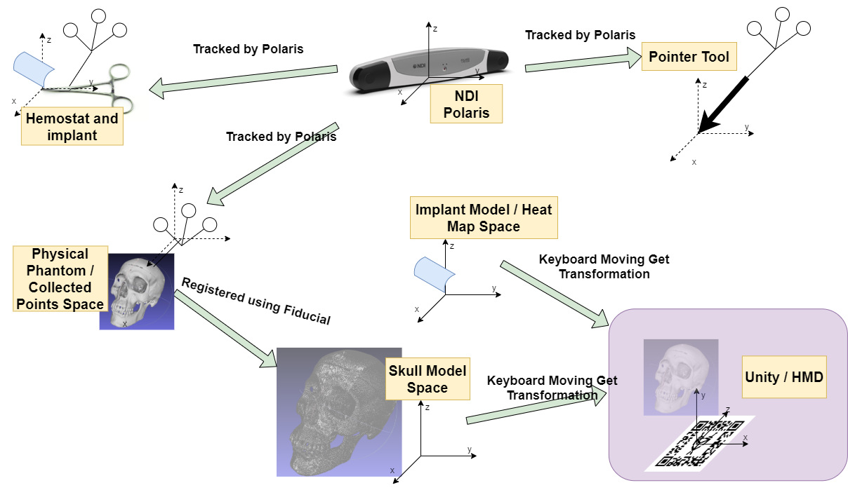
Transformation Map

Slide 6
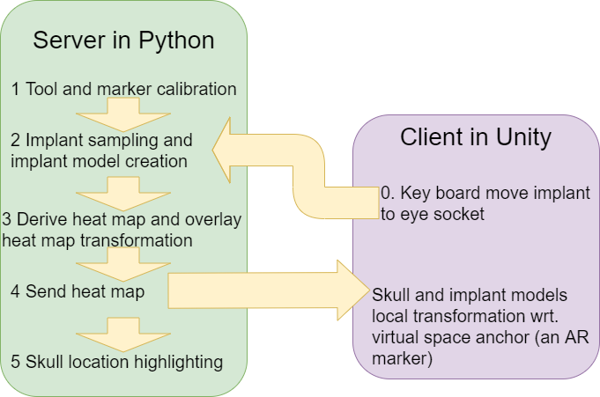
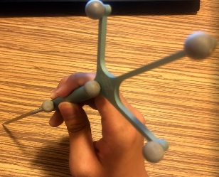
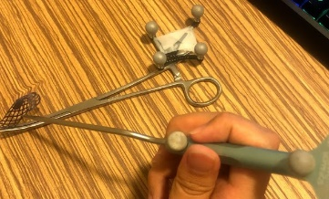
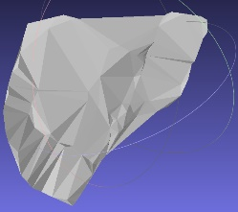
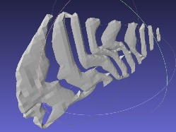
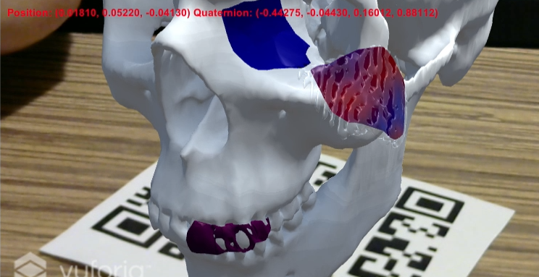
System Diagram
1.
2.
3.
UDP
4. & 5.
(Surface on teeth: another application of Unity mesh – highlighting interested anatomic region.)

Slide 7
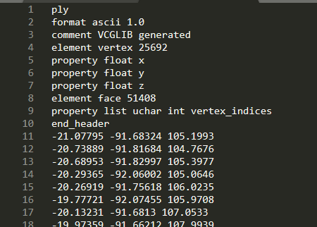
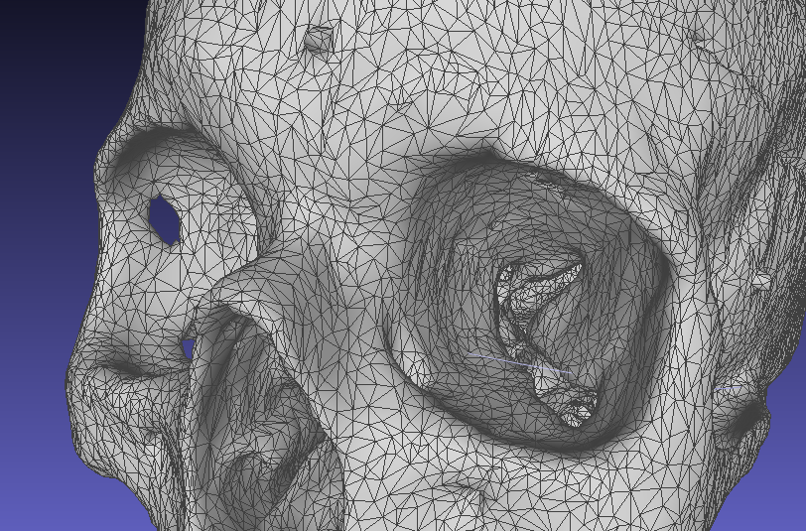
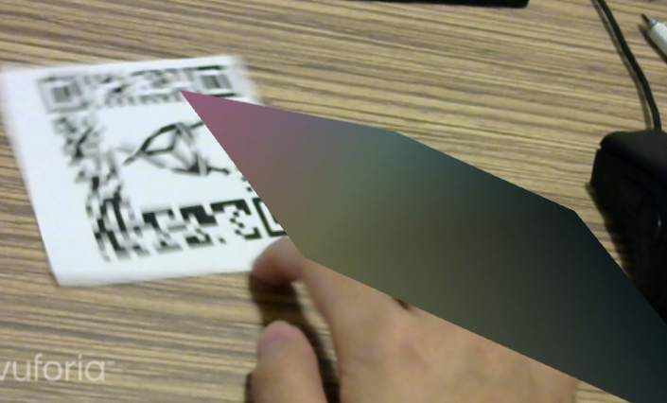
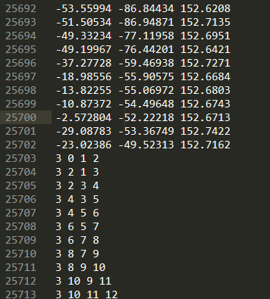
Heat Map – Mesh
Simple concept demo:
- Three triangles
- Colored vertices
Model mesh
Vertices
Triangle indices
.ply polygon file

Slide 8
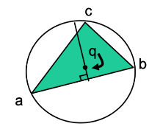
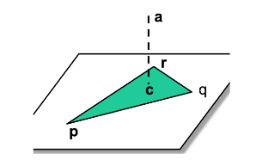
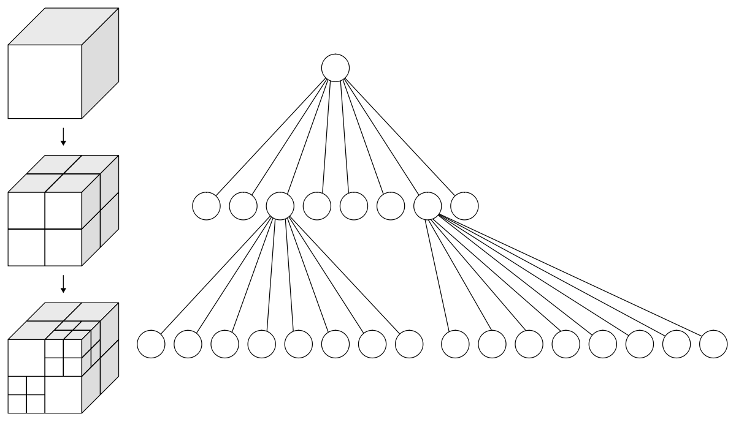
Closest Point Algorithm
Bounding Spheres
Triangle center
Octree
Images from Computer-integrated Surgery I JHU, Russ H. Taylor

Slide 9
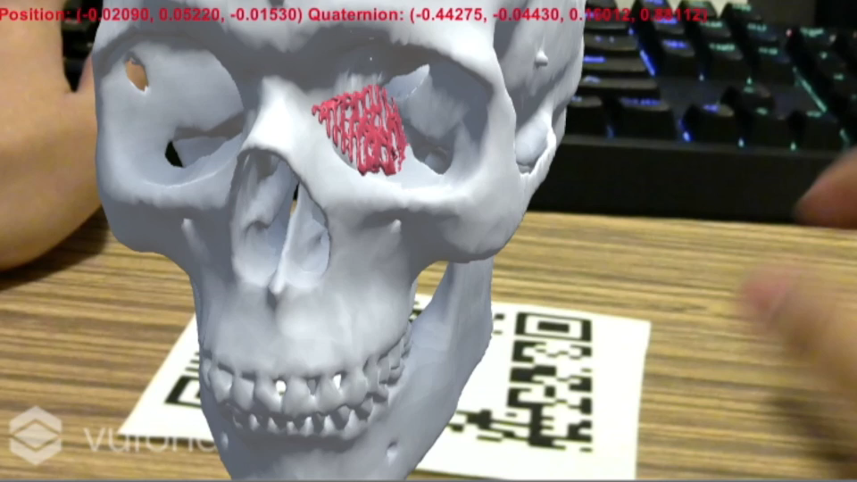
Demo
(Surface on teeth: another application of Unity mesh – highlighting interested anatomic region.)

Slide 10
Challenges and Future Works
Unity handedness
Convert to left handedness first, then do transformation
Data handling
.ply file read and write
Mesh data transmission (full buffer)
Procedure time
3 minutes excluding pivot calibration (searching algorithm takes longest)
Automated procedure
Substitute keyboard input (possibly voice control)

Slide 11
Mesh - Other Application
Model high-lighting (interested anatomical region)
Educational use
Multi-user interaction
CT image visualization

Slide 12
Works in other projects
Thank you
Closest point algorithm – Yihao Liu, Tim Bernard, Programming Assignment 4 CIS I
Polaris interface – Yihao Liu, Nikhil Dave, AR assisted craniofacial surgery, CIS II project
Reading List
Hussain, R., Lalande, A., Guigou, C., and Bozorg Grayeli, A. (2019). Contribution of Augmented Reality to Minimally Invasive Computer-Assisted Cranial Base Surgery, IEEE Journal of Biomedical and Health Informatics.
Gsaxner C., Pepe, A., Wallner, J., Schmalstieg, D., and Egger, J. (2019). Markerless Image-to-Face Registration for Untethered Augmented Reality in Head and Neck Surgery, MICCAI 2019.
Li, Y., Chen, X., Wang, N., Zhang, W., Li, D., Zhang, L., Qu, X., Cheng, W., Xu, Y., Chen, W., and Yang, Q. (2018). A wearable mixed-reality holographic computer for guiding external ventricular drain insertion at the bedside, Journal of Neurosurgery JNS, 131(5), 1599-1606.

